Slide 1
Design and implementation of ship engineering project management system
By Disha Shah
1911053

Slide 2
ABSTRACT This paper demonstrates how to use the SQL Server database for data organization and system development for the project management process of ship engineering companies.
By considering system requirements from the bottom up, and considering data requirements from the top down, a general model containing ship product data is developed.
It solves the problems of cluttered project information, difficult information integration, and chaotic process management.
It will aim in improving management efficiency and reducing management costs.

Slide 3
Introduction The system is designed and implemented in combination with the actual situation of ship engineering, and the importance, necessity and feasibility of the ship engineering project management system are discussed in detail.
Abandon paper office to save company costs and reduce waste of human resources.
Categorize and organize the information reasonably and scientifically.
The project can analyze the report and grasp key information at any time.
The database management of the ship engineering project allows the staff on the entire project process to know the project progress clearly and understand their work needs in time.

Slide 4
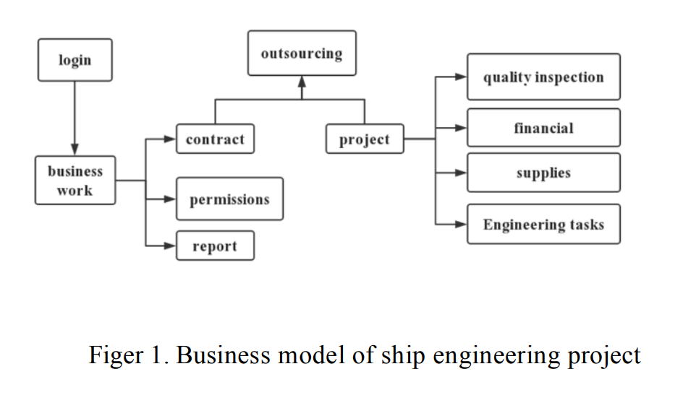
Through the construction of a ship engineering project management system, safety, stability, and ease of use are increased, and the ability to digitally store and share information is realized.
SHIP ENGINEERING PROJECT BUSINESS MODEL

Slide 5
DEMAND ANALYSIS OF SHIP ENGINEERING PROJECTS

Slide 6
With the economic globalization, the current ship market competition is very fierce, in order to improve competitiveness. The quality of the project management by the project manager directly affects employees' work efficiency, company efficiency, and corporate reputation.
A. Features of ship engineering projects
The characteristics of shipbuilding projects involve :
many manufacturers,
long project cycles,
large overall scale,
complicated links and overlapping conditions,
and large project funds.

Slide 7
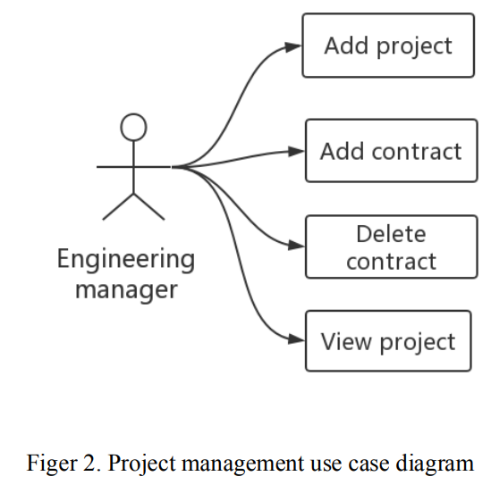
Ship engineering management is mainly divided into three parts: 1. engineering business, 2. engineering settlement, and 3. engineering subcontracting.
B. Functional requirements analysis of ship engineering project system

Slide 8
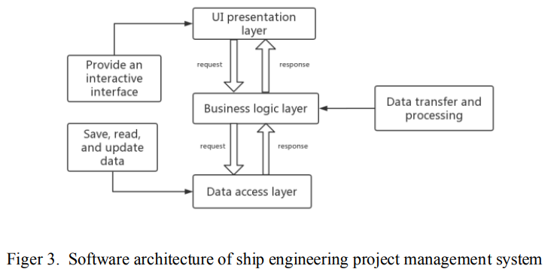
DESIGN OF SHIP ENGINEERING PROJECT MANAGEMENT SYSTEM A detailed design diagram to guide the developer to complete the system construction is made in this phase.
The system uses the current mature and stable three-tier architecture technology which is divided into:
presentation layer,
business logic layer, and
data access layer.

Slide 9
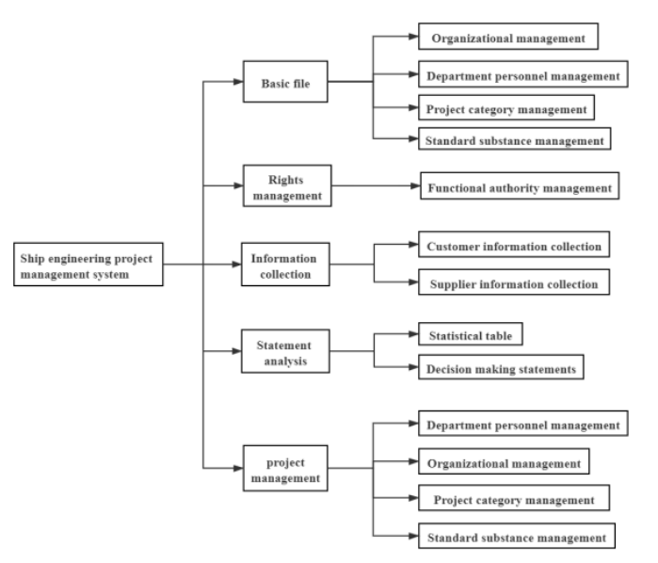
By analyzing and summarizing the status quo of the enterprise, the function of the ship engineering project management system is designed.
The research of this project covers the following:
Perform analysis during the preparation phase of the ship engineering project management system.
Carry out a detailed requirements analysis, mainly focusing on the current situation of the enterprise.
Establish a plan in the system of the ship engineering project management system.

Slide 10
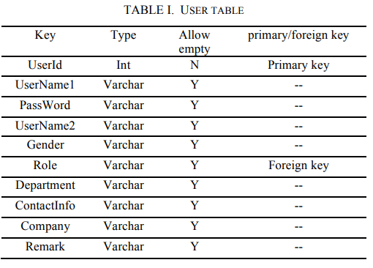
The system's database physical structure is designed through a data dictionary, reflecting the length, type, and data results of each table field. The purpose is to explain the data items of each table.

Slide 11
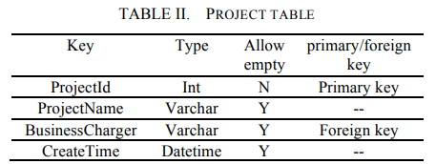
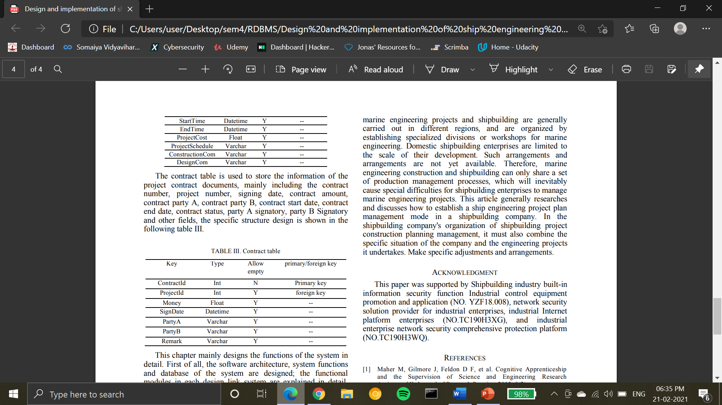

Slide 13
Conclusion
This article generally researches and discusses how to establish a ship engineering project plan management mode in a shipbuilding company. In the shipbuilding company's organization of shipbuilding project construction planning management, it must also combine the specific situation of the company and the engineering projects it undertakes and accordingly make specific adjustments and arrangements.

Slide 14
BIBLIOGRAPHY
https://www.semanticscholar.org/paper/Use-of-Value-Engineering-to-Develop-Creative-Design-Tang-Bittner/b0e73b18c505dee588936a144190b6892dfedb80
https://en.wikipedia.org/wiki/Marine_engineering

Slide 15
Strategy for implementation
Creating a relational database for the system
Creating the user, project and contract tables
Creating a few more useful tables
Project team table
Departments table
Adding a few more attributes to the tables given in the paper

